Slide 1

NARPM
Leadership Symposium
Facilitator: Dave Phillips, CAE

Slide 2
Leadership is a journey, not a destination.

Slide 3
NARPM Leadership Symposium
For current and aspiring volunteer leaders
A series of leadership lessons and discussions
  October – two 1.5-hour presentations
  November – Five 1-hour presentations
  December – 30-minute check-in with Chapter leaders
  February – 30-minute discussion of holding volunteers accountable
  April – 30-minute discussion on leadership topic
  May – spokesperson training
  October – Leadership Recognition event and start of new program
  Monthly Leadership Calls with Chapter Leaders and NARPM Leaders

Slide 4
Today
  Understanding Impactful Leadership
    Leadership vs. Management
    Partnering with Staff for Success
    Your Role, Expectations and Obligations
  Culture and Strategy
    Understanding the Five Leadership Personalities
    Surrounding Yourself with Talent
    Setting Expectation

Slide 5
Understanding Impactful Leadership
Leadership vs. Management
Partnering with Staff for Success
Your Role, Expectations and Obligations

Slide 6
Leadership vs Management
Management consists of controlling a group or a set of entities to accomplish a goal. Leadership refers to an individual's ability to influence, motivate, and enable others to contribute toward organizational success. Influence and inspiration separate leaders from managers, not power and control.

Slide 7
Three Tests for Lead vs Manage
Creating value vs Counting value
Circles of influence vs Circles of power
Leading people vs Managing work

Slide 8
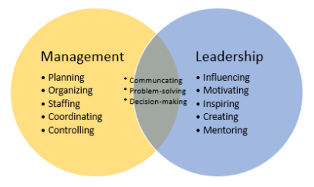
Leadership vs Management

Slide 9
Leadership vs Management
Leadership is mission-driven while management is task-driven.
Leaders coach, while managers direct.
While a leader keeps a team focused on the overall purpose of their work, a manager keeps a team focused on completing a task.
Leaders can be transformational and inspire people to achieve high-quality work, while managers control people and their work.
Leaders are innovative while managers follow the books.
Leaders take risks, while managers control risk.

Slide 10
Role of Staff and Volunteer Leader
From Entrepreneur Caribbean

Slide 11
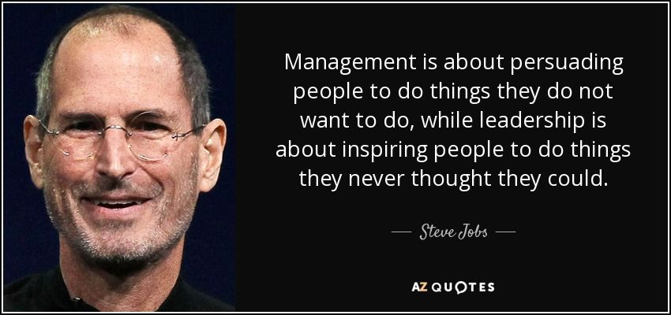

Slide 12
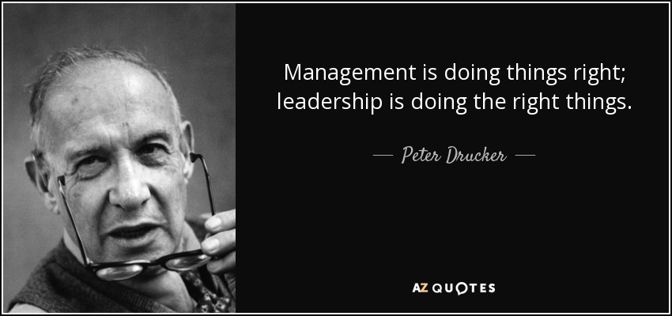

Slide 13
Partnering with Staff for Success
“We must, indeed, all hang together or, most assuredly, we shall all hang separately.”
Benjamin Franklin

Slide 14

Staff/Volunteer Partnership
An Arranged Marriage
A Business Partnership
A Therapist and a Patient
A Boss and an Employee
A Coach and a Player
A Bug and a Windshield

Slide 15
What Constitutes Success?
We will be successful if by the end of the year
_______________________________________________ _____________________________________________________________________________________________________________________________________________

Slide 16
The Ultimate Success
You’ll know you had a successful year if at the end you are still in the real estate business and staff is still in the association business.

Slide 17
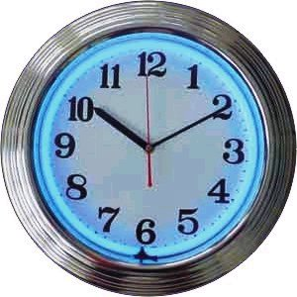
When to communicate?
Your goals/ideas?
Troubling association financial news?
Personnel Issues/personal Issues?
Items for the meeting agenda?
Negative member feedback?
Your vacation schedule?

Slide 18
Rules of Engagement
Preferred Device
Issue
Phone
Text
Email
Social Media
Mail
In person
Other
Urgent question
Signature required
FYI
Minutes for review
Calendar appointment
Feedback
Bad news

Slide 19
Follow the team approach
You look good when they look good…and bad when they look bad
It is not about “me” – its about “we”
Consider enrolling others – Leadership Team
It is NOT about either of you

Slide 20
Your Role, Expectations and Obligations
A volunteer leader, like any performer, must understand their role in the show, feel the expectations of their audience, and fulfill the obligations that come with being the star.

Slide 21

Typical Roles of a Volunteer Leader
Meeting Chair
Industry Expert
Confidant
Complaint Department
Public Speaker
Referee
Decision Maker
Hero/Goat

Slide 22

Roles Not for a Leader
Boss/Dictator
Manager
Opinionator
Friend
Worker

Slide 23

What Your Followers Expect
Know Where to Find the Answers
Good Listener
Expert
Professional Image
Be Present
Thankful and Humble
Strong and Fair
Clear Communications

Slide 24
Missed Expectations…
…lead to a loss of trust. Without trust, you cannot lead.

Slide 25

Obligations of a Leader
Arrive Early
Start Meetings On-time
Respond Promptly
Be Prepared
Handle Problem Members
Keep Discussions On-track
Hold Yourself and Others Accountable

Slide 26
Questions and Comments
Connect with Dave
Twitter – Dave_Phillips7
Email – DavePhillips82@gmail.com
Facebook - https://www.facebook.com/PhillipsLeadership
LinkedIn - https://www.linkedin.com/in/daverphillips7/

Slide 27
Culture and Strategy
    Understanding Five Challenging Leadership Personalities
    Surrounding Yourself with Talent
    Setting Expectation

Slide 28
Five Challenging Leadership Personalities
One-Armed Paper Hanger
Silent Assassin
Nitpicker
Loose Cannon
Megalomaniac

Slide 29

One-Armed Paper Hanger

Slide 30
Issues of One-Armed Paper Hangers
Lack of timely response
Avoid responsibility
Trouble making decisions
Dwell on unimportant things
Always late

Slide 31
Success Strategies
Agree to a communications plan
“If you don’t hear from me by…”
Never ask open ended questions – always present solutions/answers.
Don’t communicate too far in advance.
Use good Subject Lines in emails.

Slide 32

Silent Assassin
Silent Joe
Assassin

Slide 33
Issues of Silent Assassins
Lack of trust
Excess drama
Disharmony of organization
Extra stress (for support staff)
Decrease in creativity/productivity

Slide 34
Success Strategies
Communicate in writing
CC other officers
Don’t hold one-on-one meetings/calls
Focus on Strategic Plan
Ask others to call you out

Slide 35

Nitpicker

Slide 36
Issues of Nitpickers
Lack of respect/appreciation.
Stymie creativity and initiative.
Dampen the mood of staff.
Never happy.

Slide 37
Success Strategies
Find a way to channel your helpfulness.
Write your own material.
Use sandwich feedback (positive-negative-positive)
Go out of your way to praise staff.

Slide 38

Loose Cannon

Slide 39
Issues of Loose Cannons
Make promises that can’t be delivered.
Say things that offend people.
Attract other loose cannons.
Distract from following Strategic Plans.
Change directions often.

Slide 40
Success Strategies
Ask for feedback with actual examples.
Set up regular communications.
Use a leadership team to balance.
Find something in the Strategic Plan to embrace.

Slide 41

Megalomaniac

Slide 42
Issues of Megalomaniacs
Fail to share credit.
Fail to seek input or listen to advice.
Don’t share the limelight.
Don’t encourage future leaders.
Want to build a legacy.

Slide 43
Success Strategies
Establish a Leadership Team approach.
Find other ways to feed the beast.
Use other leaders to nurture future leaders.
Make your legacy by working the Strategic Plan.

Slide 44
Thriving by Choice
Be open with others about your personality.
Surround yourself with people who balance you.
Ask for feedback.
Find a mentor or coach.
Read books and take training.

Slide 45
Surrounding Yourself with Talent

Slide 46
If you are the smartest person in the room…
…you are in the wrong room.

Slide 47
If you only ask carpenters for a solution…
…all problems will be fixed with a hammer and nails.

Slide 48
If you all look alike…
…people will assume you all think alike.

Slide 49
Leading with a Team
You must be willing to share the credit
Prepares future leaders
Attracts future leaders
Builds consistency over the years
Instant credibility for decisions
Provides checks and balance for decisions

Slide 50
Setting Expectation

Slide 51
If they don’t know what you expect…
…they’ll only give you what you already have.

Slide 52
Setting Expectations
Unclear
“Our committees are not working well. Will you chair a work group to talk about this?”
Clear
“Our committees are not working well. They no longer align with our strategic plan, they don’t have a clear purpose, and the same people serve on them every year.
“Will you chair a work group to restructure our committees to align them with the strategic plan, clarify their purpose, and rework how committee members are selected.”

Slide 53
Set Clear Expectations
Deadlines
Communications
Timeliness
Behavior
Committee leaders and members
Staff

Slide 54
Questions and Comments
Connect with Dave
Twitter – @Dave_Phillips7
Email – DavePhillips82@gmail.com
Facebook - https://www.facebook.com/PhillipsLeadership
LinkedIn - https://www.linkedin.com/in/daverphillips7/

Slide 55
Reading List
https://entrepreneurcaribbean.com/2020/02/26/leadership-versus-management/
https://fairygodboss.com/career-topics/leadership-vs-management
https://momentumnonprofitpartners.org/help-desk-1/2018/3/4/leadership-board-staff-and-voluntieers

